Slide 1
Prediction of Moment Capacity of
Corroded RC Beams
Reinforcement Corrosion: the hidden enemy turning strong structures into ticking time bombs.

Slide 2
RC Beam Corrosion Impact
Reduced bending capacity and ductility in reinforced concrete (RC) members suffering from reinforcement corrosion is a crucial issue among existing RC infrastructure worldwide.
Flexural stiffness degrades with increasing corrosion damage as the interfacial bond between concrete and steel is gradually lost and cracking proliferates across the member surface.
The tension stiffening effect, which allows the transfer of stresses from the reinforcement to the surrounding concrete, is reduced as corrosion continually diminishes bond strength and reinforcement cross-sectional area.

Slide 3
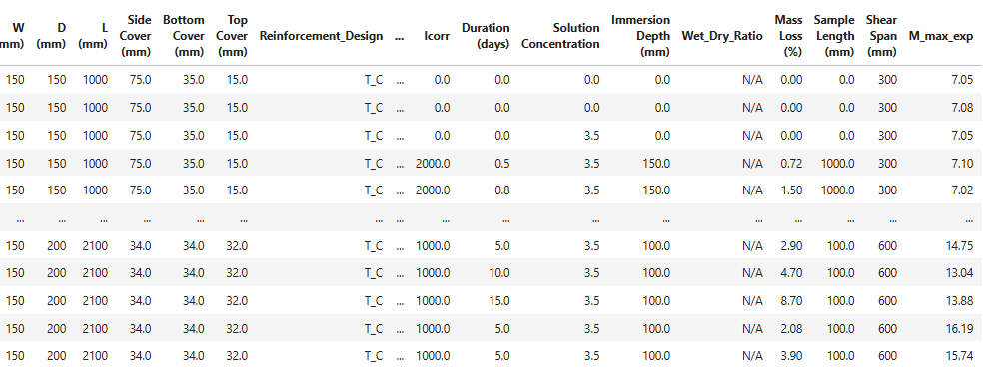
Dataset

Slide 4
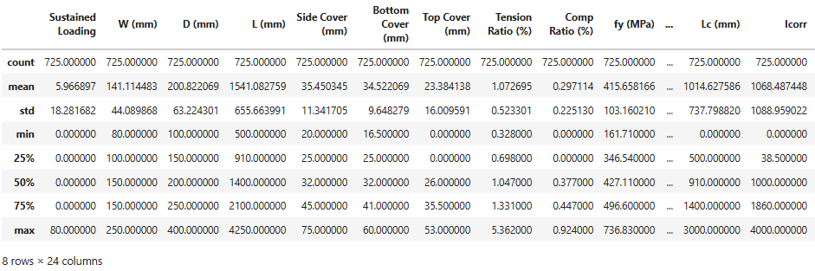
Statistics

Slide 5
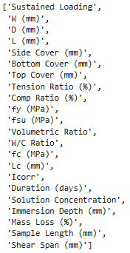
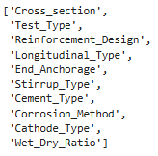
Input Features
~ 800 Sample Bending Tests
32 Input features
22 Numerical Features
10 Categorical Features

Slide 6
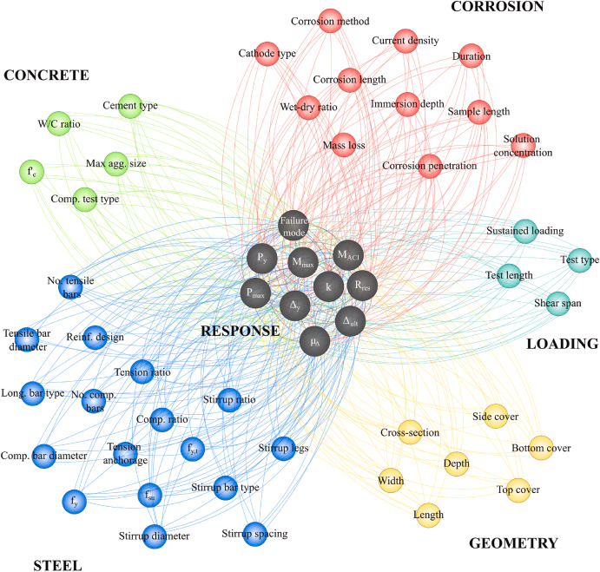
Input Features

Slide 7
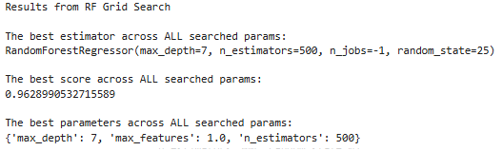
Random Forest Regressor Results

Slide 8
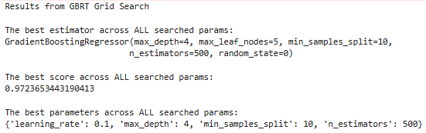
Gradient Boosting Regressor Results

